Slide 1

L1.1 Introduction and Overview
Zonghua Gu 2023

Slide 2
Course Logistics
Course homepage: https://guzonghua.github.io/saav/
Lectures Mon & Wed 15:30-17:00 via Zoom. Link: https://umu.zoom.us/j/62818040552
Instructor: Zonghua Gu, zonghua.gu@umu.se

Slide 3
My Instruction Style
No textbook. Will discuss classic techniques as well as latest research advances.
I provide detailed, self-contained PowerPoint slides.
All exam questions come from these slides. Some slides may be verbose for the sake of completeness.
In-class questions and discussions are welcome. You can either speak up during lecture, or type in the chat window. For questions after class, please use the Canvas discussion board so everyone can see the discussions.
Lecture videos are recorded and available in UmU Play, so in-class attendance is not mandatory.

Slide 4
Lecture Schedule (Tentative)
I will put lecture materials here instead of on Canvas. Please bookmark this link
https://guzonghua.github.io/saav/ (under construction)
Since slides may be updated slightly after each class, it is more convenient to put them here
Previous course homepages available on https://guzonghua.github.io/saav2022/ and https://guzonghua.github.io/saav2021/
Contents updated every year
Notes:
Weekly lecture topics
Website under construction
W1: Introduction and overview
W2: Perception (Intro to ML/DL, CNN)
W4: Planning
W5: Control algorithms (PID, MPC)
W6-7: (Deep) Reinforcement Learning
W8-9: RL applications in AD
W10-11: Advanced topics (security attacks and defenses, uncertainty estimation, out-of-distribution detection…)
Sensor fusion with filters (Kalman, Particle, UKF)

Slide 5
Grade Distribution
Final exam (open-book): 60%
Lab sections: 40%

Slide 6
Three Labs
Lab1 in W3-4. Adversarial attack on CNN for traffic sign classification
Lab2 in W7-8. PID control
Lab3 in W9-10. Planning for Highway Driving with DQN RL
https://github.com/guzonghua/saavlabs
Notes:
Unity ML (https://unity3d.com/machine-learning).
Lab1: PID controller for lane tracking
Lab2: MPC controller for trajectory optimization
Lab3: Reinforcement Learning (DQN)
Lab4: Reinforcement Learning (PPO or Actor-Critic)
Kalle will provide brief tutorials on related software frameworks throughout the term

Slide 7
Details of Labs
We will keep the programming workload relatively low, e.g., you may be given a semi-complete program, and asked to tune some hyper parameters, or fill in a few lines of missing code (no large-scale coding)
We will keep the computing demands low, so you can use Google Colab, or work on your own computer without powerful GPUs. (Programming language is Python.)

Slide 8
Final Exam Format
Multiple choice questions, e.g.
Which path planning algorithm(s) are guaranteed to find the optimal solution?
A. A* algorithm
B. Rapidly-exploring Random Tree (RRT)
C. Probabilistic Roadmap (PRM)
D. All of them
E. None of them
Simple calculation questions, e.g.,
Convolutional Neural Networks I
Input volume: 56×56×64 (𝑊1=𝐻1=𝑁1=56,𝐷1=64). 32 1×1×64 filters (𝐾=32,𝐹=1) w. stride 𝑆=1, no pad 𝑃=0. Show the formulas and calculation process.
1) Calculate the dimensions of the output volume, including spatial size and depth.
2) Calculate the total number of parameters, including weights and biases.

Slide 9
Pass or Fail?
In the past, the vast majority of students pass the course, if they put in reasonable effort
The course workload is not very high. Most students manage it quite well
Use the anonymous feedback link to provide comments on course pace, level of difficulty, etc.

Slide 10
Today’s Agenda
I will give a broad overview of the major issues involved in AD.
Background
Sensors and perception
HD maps
Hardware platforms
Software platforms
V2X
Ethical Issues

Slide 11
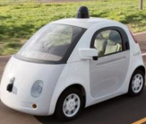
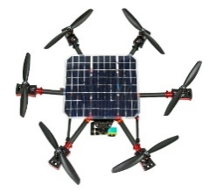
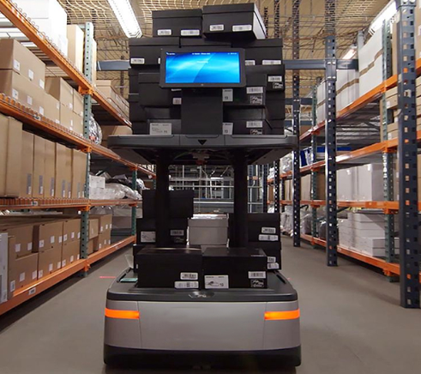
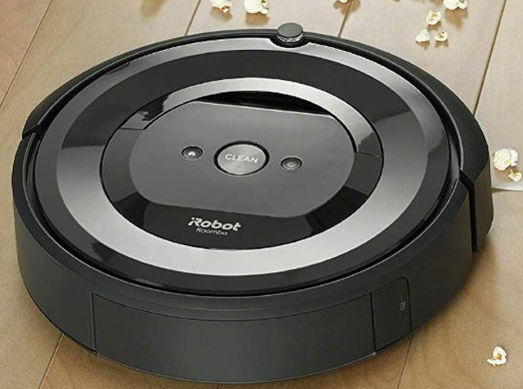
Autonomous Vehicles (AVs)
Can refer to any type of Autonomous Mobile Robot.
Not just Self-Driving Cars (SDCs)
Many techniques for SDCs covered in this course are generally applicable to other types of AVs.
Self-Driving Cars
Drones
Warehouse Robots
Indoor-Cleaning Robots

Slide 12
Why AD?
Reduced traffic accidents and fatalities
In the USA: in 2019, an estimated 38,800 people lost their lives to car crashes. About 4.4 million people were injured seriously enough to require medical attention in crashes.
Reduced congestion and pollution
More productive time spent on the road
Autonomous Mobility-on-Demand (AMoD) with a fleet of AVs
Low-cost, safe and efficient mode of transportation that may make vehicle ownership obsolete.
The dream of Uber (and many other companies)
Notes:
An average North American
spends 100 minutes per day driving.
total of ~38k hours, 1.3 million miles in his/her lifetime, which is more than 3x distance to the moon.
Traffic deaths – a 2% decline from 2018 (39,404 deaths) and a 4% decline from 2017 (40,231 deaths)
~1.25 million fatalities globally
https://www.nsc.org/road-safety/safety-topics/fatality-estimates

Slide 13
Advanced Driver Assistance (ADAS)
Since the initial introduction of Cruise Control in 1948, ADAS functions are increasingly prevalent in modern vehicles.
Adaptive cruise control (ACC), Anti-lock braking system, Collision avoidance system (Pre-crash system), Driver Monitoring System (DMS), Electronic Stability Control (ESC), Forward Collision Warning (FCW), Lane Departure Warning (LDW), Lane Change Assistance, Surround View…
https://en.wikipedia.org/wiki/Advanced_driver-assistance_systems

Slide 14
DARPA Grand Challenge (2004)
Held in the Mojave Desert region of the USA, along a 150-mile route.
None of the robot vehicles finished the route. Carnegie Mellon University's Red Team and car Sandstorm (a converted Humvee) traveled the farthest distance, completing 7.32 mi of the course before getting hung up on a rock after making a switchback turn.
No winner was declared, and the cash prize was not given.

Slide 15
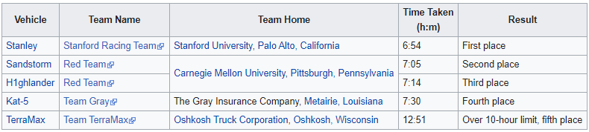
DARPA Grand Challenge (2005)
Vehicles passed through three narrow tunnels and negotiated more than 100 sharp left and right turns.
Five vehicles successfully completed the 132 mi course. Stanford’s Stanley won the $2M top prize.

Slide 16
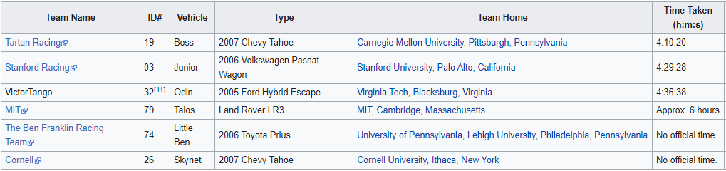
DARPA Urban Challenge (2007)
Held at the site of the now-closed George Air Force Base. The course involved a 60 mi urban area course, to be completed in less than 6 hours. Rules included obeying all traffic regulations while negotiating with other traffic and obstacles and merging into traffic.
The 3 Grand Challenge races jump-started the Self-Driving Car industry. Faculty and students from winning teams such as Stanford and CMU later became leaders in SDC projects at companies like Google/Waymo and Uber and numerous startups.
Notes:
CMU’s Boss won the $2M top prize, and Stanford’s Junior won the $1M second prize.

Slide 17
Highway vs. City Driving
Highway driving is perceived as an easier problem than city driving.
Has potential of massive displacement of truck driver jobs
But traffic merging is tricky and may require human operator assistance
 | Highway Driving | City Driving
Travel Speed | High | Low to medium
Traffic Volume | High | Medium to high
Number of Lanes | Large (6-8) | Small (2-4)
Others | Entry and exit points for traffic merging | Many intersections with traffic lights

Slide 18
Brief History of AVs
Google’s AV passes a 14-mile driving test in Nevada
Uber hires 40 CMU robotics researchers to work on AVs; Ford begins testing its AVs.
NHTSA issues revised safety guidelines for AVs
DARPA Grand Challenges
Google begins AV project
Tesla releases Auto-Pilot
2004/05
2009
2012
2015
2015
2017
2007
2013
2013
2016
2016
DARPA Urbane Challenge
Mercedes and Infiniti produce cars with radar sensors and some AD features
NHTSA
releases initial policy on AVs
Major acquisitions and partnerships (GM and Cruise Automation; GM and Lyft; Toyota and Jaybridge Robotics; Uber and Volvo)
NHTSA issues guidelines for testing and deployment of AVs
https://www.mcca.com/wp-content/uploads/2018/04/Autonomous-Vehicles.pdf

Slide 19
Operational Design Domain (ODD)
The ODD defines the conditions under which a vehicle is designed to function and is expected to perform safely. The ODD includes (but isn’t limited to) environmental, geographical, and time-of-day restrictions, as well as traffic or roadway characteristics.
e.g., an autonomous freight truck might be designed to transport cargo from a seaport to a distribution center 30 Km away, via a specific route, in day-time only. This vehicles ODD is limited to the prescribed route and time-of-day, and it should not operate outside of it

Slide 20
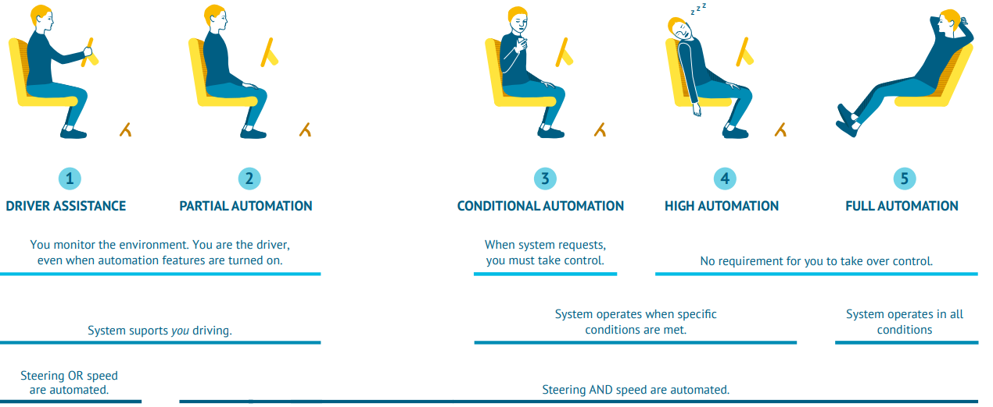
Five Levels of Automation
L1: ADAS features that either control steering or speed to support the driver.
L2: both steering and acceleration are simultaneously handled by AD system. The human driver still monitors the environment and supervises the support functions.
L3: Conditional automation: the system can drive without the need for a human to monitor and respond. However, the system might ask a human to intervene, so the driver must be able to take control at all times.
L4: These systems have high automation and can fully drive themselves under certain conditions. The vehicle won’t drive if not all conditions are met.
L5: Full automation, the vehicle can drive wherever, whenever, with unlimited ODD.
https://www.wevolver.com/article/2020.autonomous.vehicle.technology.report
Notes:
https://www.sae.org/news/press-room/2018/12/sae-international-releases-updated-visual-chart-for-its-“levels-of-driving-automation”-standard-for-self-driving-vehicles
Level 1 (L1): Advanced Driver Assistance Systems (ADAS) are introduced: features that either control steering or speed to support the driver. For example, adaptive cruise control that automatically accelerates and decelerates based on other vehicles on the road. Level 2 (L2): Now both steering and acceleration are simultaneously handled by the autonomous system. The human driver still monitors the environment and supervises the support functions. Levels of driving automation summary. Adapted from SAE by Wevolver. [6] Level 3 (L3): Conditional automation: The system can drive without the need for a human to monitor and respond. However, the system might ask a human to intervene, so the driver must be able to take control at all times. Level 4 (L4): These systems have high automation and can fully drive themselves under certain conditions. The vehicle won’t drive if not all conditions are met. Level 5 (L5): Full automation, the vehicle can drive wherever, whenever.
Examples are systems where the driver controls steering and the automated system controls engine power to maintain a set speed (Cruise Control) or engine and brake power to maintain and vary speed (Adaptive Cruise Control or ACC); and Parking Assistance, where steering is automated while speed is under manual control. The driver must be ready to retake full control at any time. Lane Keeping Assistance (LKA) Type II is a further example of Level 1 self-driving. The Automatic Emergency Braking feature which alerts the driver to a crash and deploys full braking capacity is also a Level 1 feature.
Level 1 ("hands on"): The driver and the automated system share control of the vehicle. Typical ADAS (Advanced Driver Assistance) functions belong to Level 1, incl.: Adaptive Cruise Control, Automatic Parking, Blind Spot Monitoring, Lane Departure Warning, Lane Keeping Assistance, Automatic Emergency Braking, Tire Pressure Monitoring…
Level 2 ("hands off"): The automated system takes full control of the vehicle: accelerating, braking, and steering. The driver must monitor the driving and be prepared to intervene immediately at any time if the automated system fails to respond properly. The shorthand "hands off" is not meant to be taken literally – contact between hand and wheel is often mandatory, to confirm that the driver is ready to intervene.
Level 3 ("eyes off"): The driver can safely turn their attention away from the driving tasks, e.g. the driver can text or watch a movie. The vehicle will handle situations that call for an immediate response, like emergency braking. The driver must still be prepared to intervene within some limited time, specified by the manufacturer, when called upon by the vehicle to do so.
Level 4 ("mind off"): No driver attention is ever required for safety, e.g. the driver may safely go to sleep or leave the driver's seat. Self-driving is supported only in limited spatial areas (geofenced) or under special circumstances. Outside of these areas or circumstances, the vehicle must be able to safely abort the trip, e.g. park the car, if the driver does not retake control. An example would be a robotic taxi or a robotic delivery service that only covers selected locations in a specific area.
Level 5 ("steering wheel optional"): No human intervention is required at all. An example would be a robotic taxi that works an all roads all over the world, all year around, in all weather conditions.

Slide 21
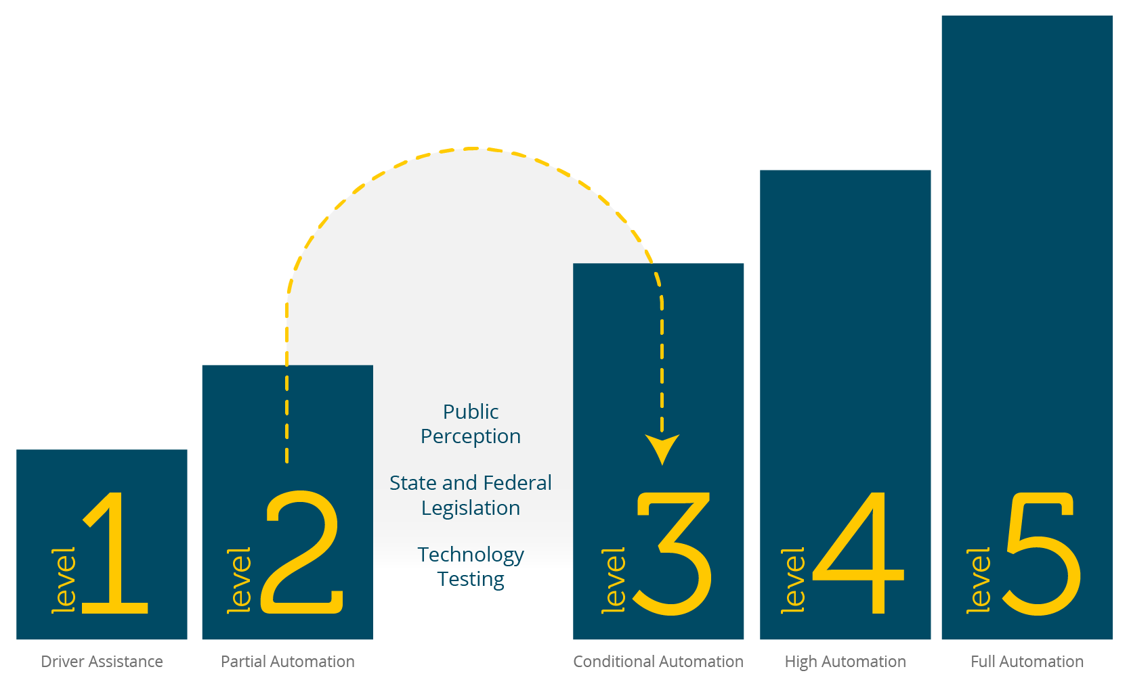
State of the Art
Current commercial products are at most L2 (e.g., Tesla Autopilot)
L2 to L3 is perceived to be a giant leap
Automakers keep pushing the timeline of L3 and above to the future…
Notes:
https://thenextweb.com/shift/2020/02/27/6-levels-autonomous-self-driving-explained-tesla-waymo-autopilot/ https://europe.autonews.com/automakers/lexus-prepares-introduce-level-2-autonomy

Slide 22
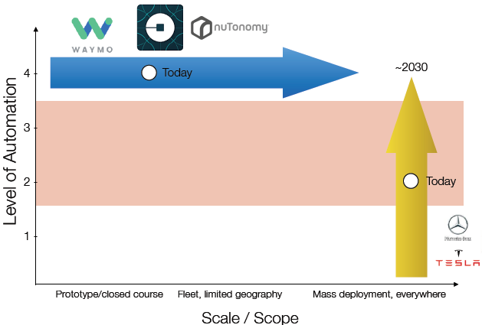
Two Different Paths to L4/5
Tesla starts from L2 and mass deployment, and gradually moves to L4/5.
Waymo, nuTonomy…starts from L4 in limited ODD, and gradually expands deployment
Emilio Frazzoli, nuTonomy

Slide 23
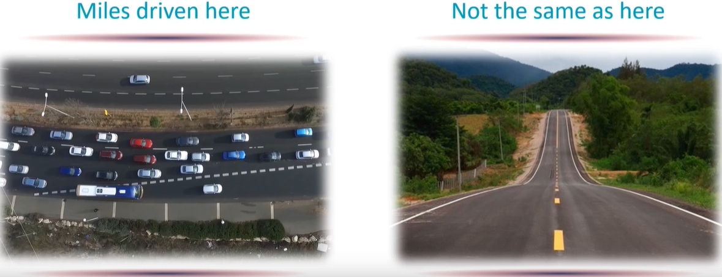
AD Safety Evaluation Metric: Miles Driven?
Not All Miles are Equal.
Driving conditions may be dramatically different.
Companies may be incentivized to avoid difficult driving conditions.

Slide 24
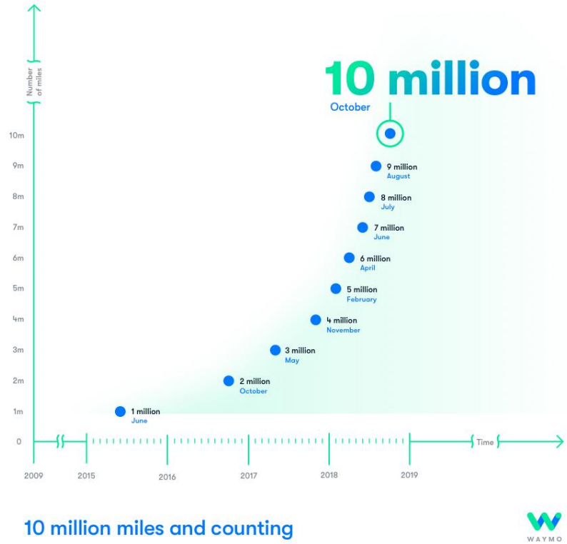
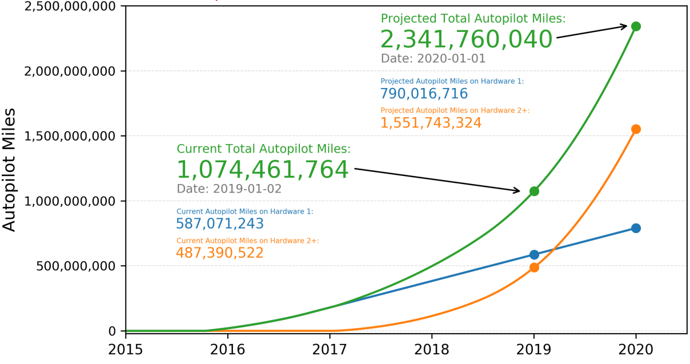
Total Miles Driven
Waymo Reaches 10 Million Miles
Tesla Autopilot Reaches 1 Billion Miles in 2019

Slide 25
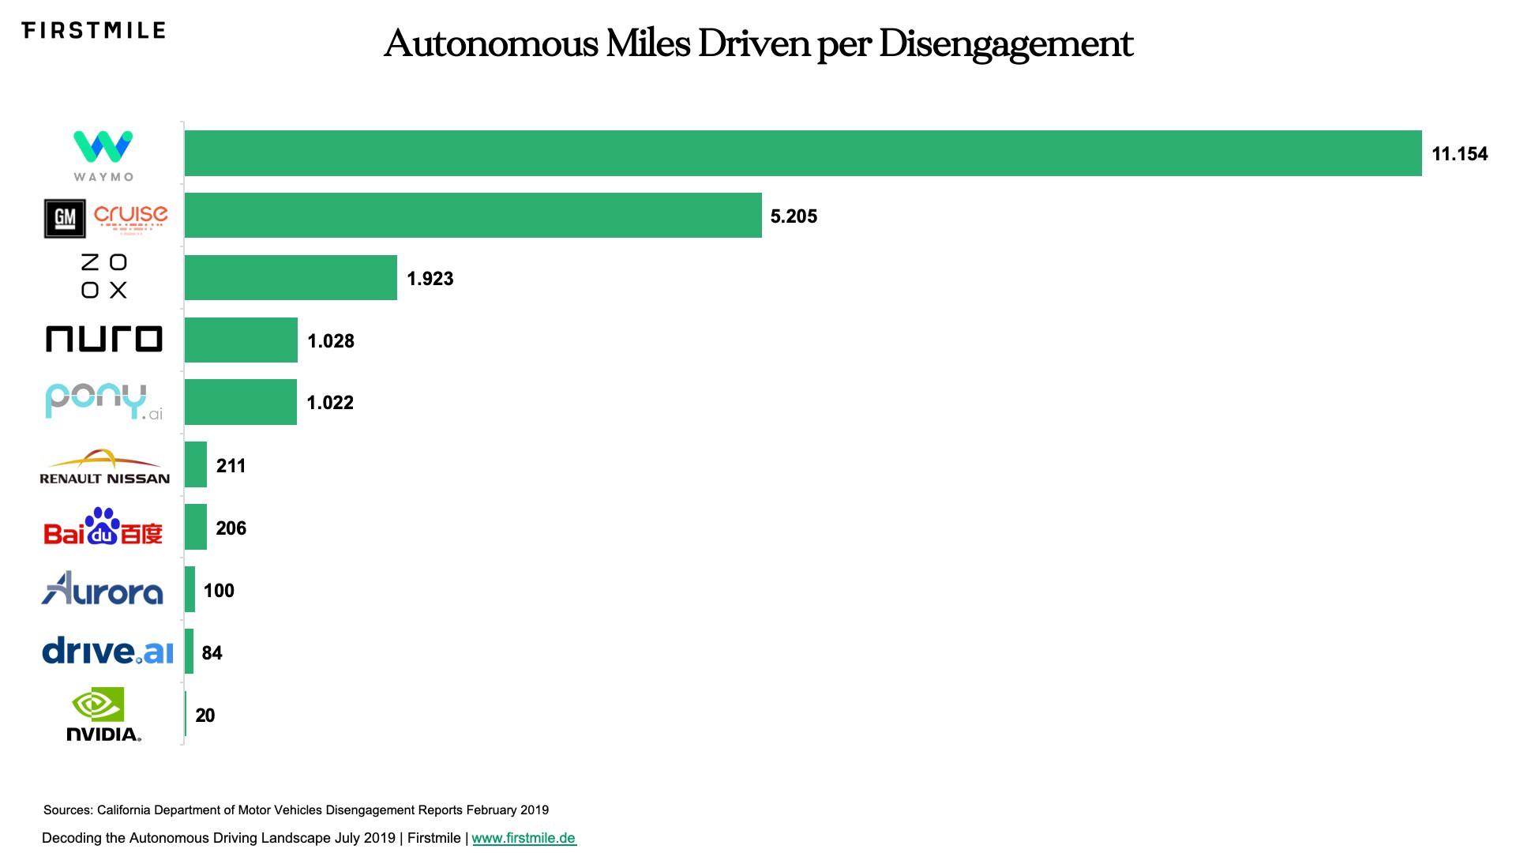
Miles Driven per Disengagement (2018)
The California Department of Motor Vehicles defines a disengagement as a “deactivation of the autonomous mode when a failure of the autonomous technology is detected or when the test driver disengages the autonomous mode.”
There is a lot of disagreement on the level of accuracy of the metric as it may be too vague, is valid only for California, and may not reflect the difficulty of the chosen driving environment.
Notes:
Disengagement is defined as human Vehicle Operator takes over control from AD system.
allows companies to avoid reporting certain road events

Slide 26
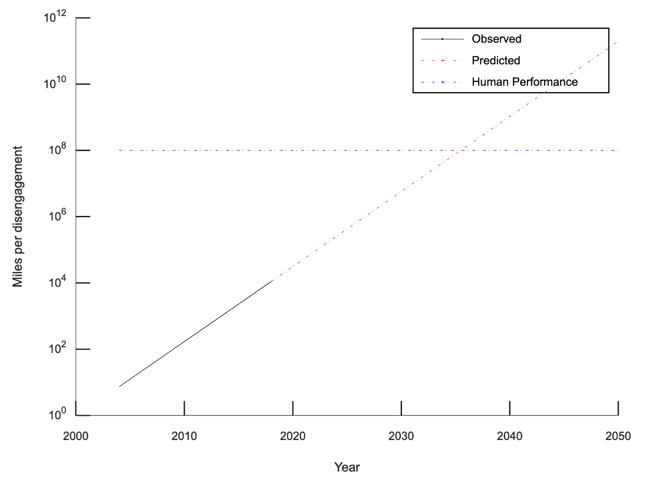
“The Moore’s Law for Self-Driving Vehicles”, Edwin Olson, CEO of May Mobility
Moore’s law in the semiconductor industry says that “the number of transistors on a chip doubles approximately every 18 months”, i.e., w. exponential growth rate
Can we have a Moore’s law for AD? “The number of miles between disengagements will double approximately every 16 months.”
Between human performance (10⁸ miles per fatality) and the best-reported self-driving car performance (10⁴ miles per disengagement) is a gap of 10,000x. Even with performance doubling every 16 months, it will reach human levels of performance in 2035.
https://medium.com/may-mobility/the-moores-law-for-self-driving-vehicles-b78b8861e184

Slide 27
When will AD Really Arrive?
Chris Urmson, co-founder and CEO of Aurora:
“In 5 years” - 2009
“In 5 years” - 2012
“In 5 years” - 2015
“In 5 years” - 2018
Notes:
By that I mean mass deployment without Human Operators to fall back on.

Slide 28
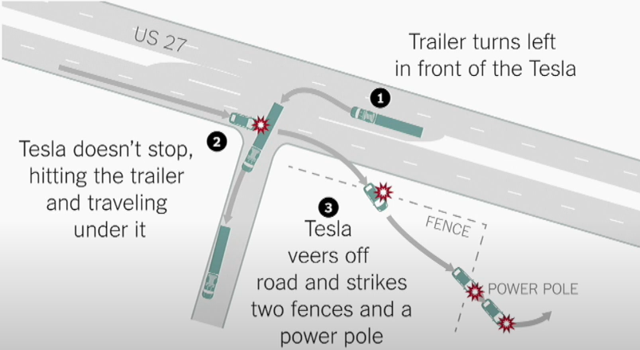
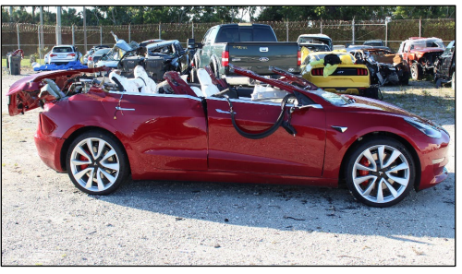
The Tesla Fatality in May 2016
The Tesla Model S (L2) was driving 74 mph on the highway when it was struck by a semitruck
The driver’s hands were off the steering wheel for a total of 37 minutes during the 37.5 minutes of time the car was in Autopilot, despite repeated visual warnings
Tesla: “Neither Autopilot nor the driver noticed the white side of the tractor trailer against a brightly lit sky, so the brake was not applied.”
A failure of computer vision algorithm for object detection; maybe a lidar could have prevented the accident.
Tesla used to use Mobileye’s hardware platform EyeQ, but they broke up after the accident, and Tesla started to develop its hardware platform FSD.
Notes:
https://www.wired.com/story/teslas-latest-autopilot-death-looks-like-prior-crash/
https://www.businessinsider.com/details-about-the-fatal-tesla-autopilot-accident-released-2017-6?r=US&IR=T
NTSB (National Transportation Safety Board)’s report noted the truck driver should have yielded to the Tesla and that the driver was inattentive.

Slide 29
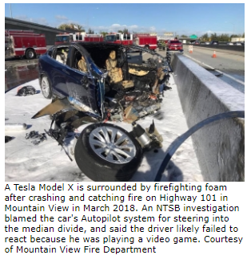
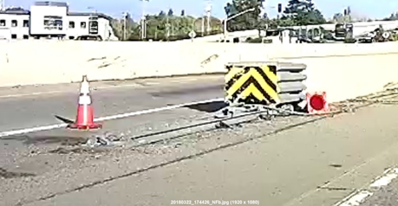
The Tesla Fatality in Mar 2018
In 2018, a man died from a high-speed crash because his Tesla Autopilot system steered the car into a median on Highway 101 in Mountain View, CA.
NTSB’s investigation report, released in Feb 2020, lists 23 findings that enumerate all the factors that contributed to the fatal collision.
Limitations on Tesla's Autopilot Lane-Keeping Assistance (LKA) caused the vehicle to veer into the median and failed to provide an alert to the driver in the seconds leading to the crash.
The collision avoidance system was not designed to detect a crash attenuator, which resulted in a severe crash in which the automatic braking and collision warning systems failed to activate.
A failure of computer vision algorithm for lane tracking.
Tesla Autopilot 2 almost crashes Into Barrier (similar to this crash)
https://www.youtube.com/watch?v=TIUU1xNqI8w
https://www.mv-voice.com/news/2020/02/25/ntsb-teslas-autopilot-steered-model-x-into-highway-median-causing-fatal-mountain-view-crash
Notes:
The Model X's collision avoidance system was not designed to detect a crash attenuator and the NHTSA does not require such capability, which resulted in a severe crash in which the automatic braking and collision warning systems failed to activate.

Slide 30
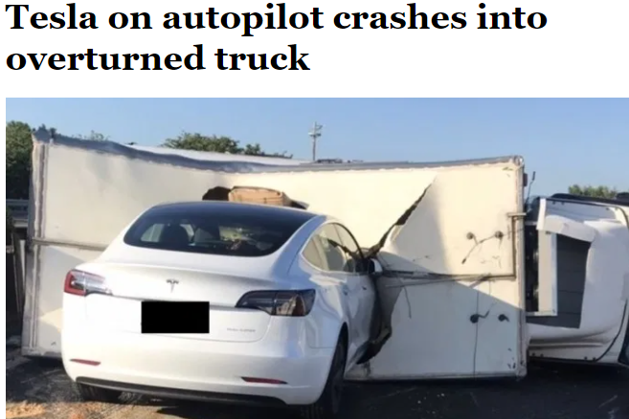
Tesla still cannot recognize white trucks in 2020
Tesla on autopilot crashes into overturned truck on busy highway in Taiwan
https://www.youtube.com/watch?v=X3hrKnv0dPQ

Slide 31
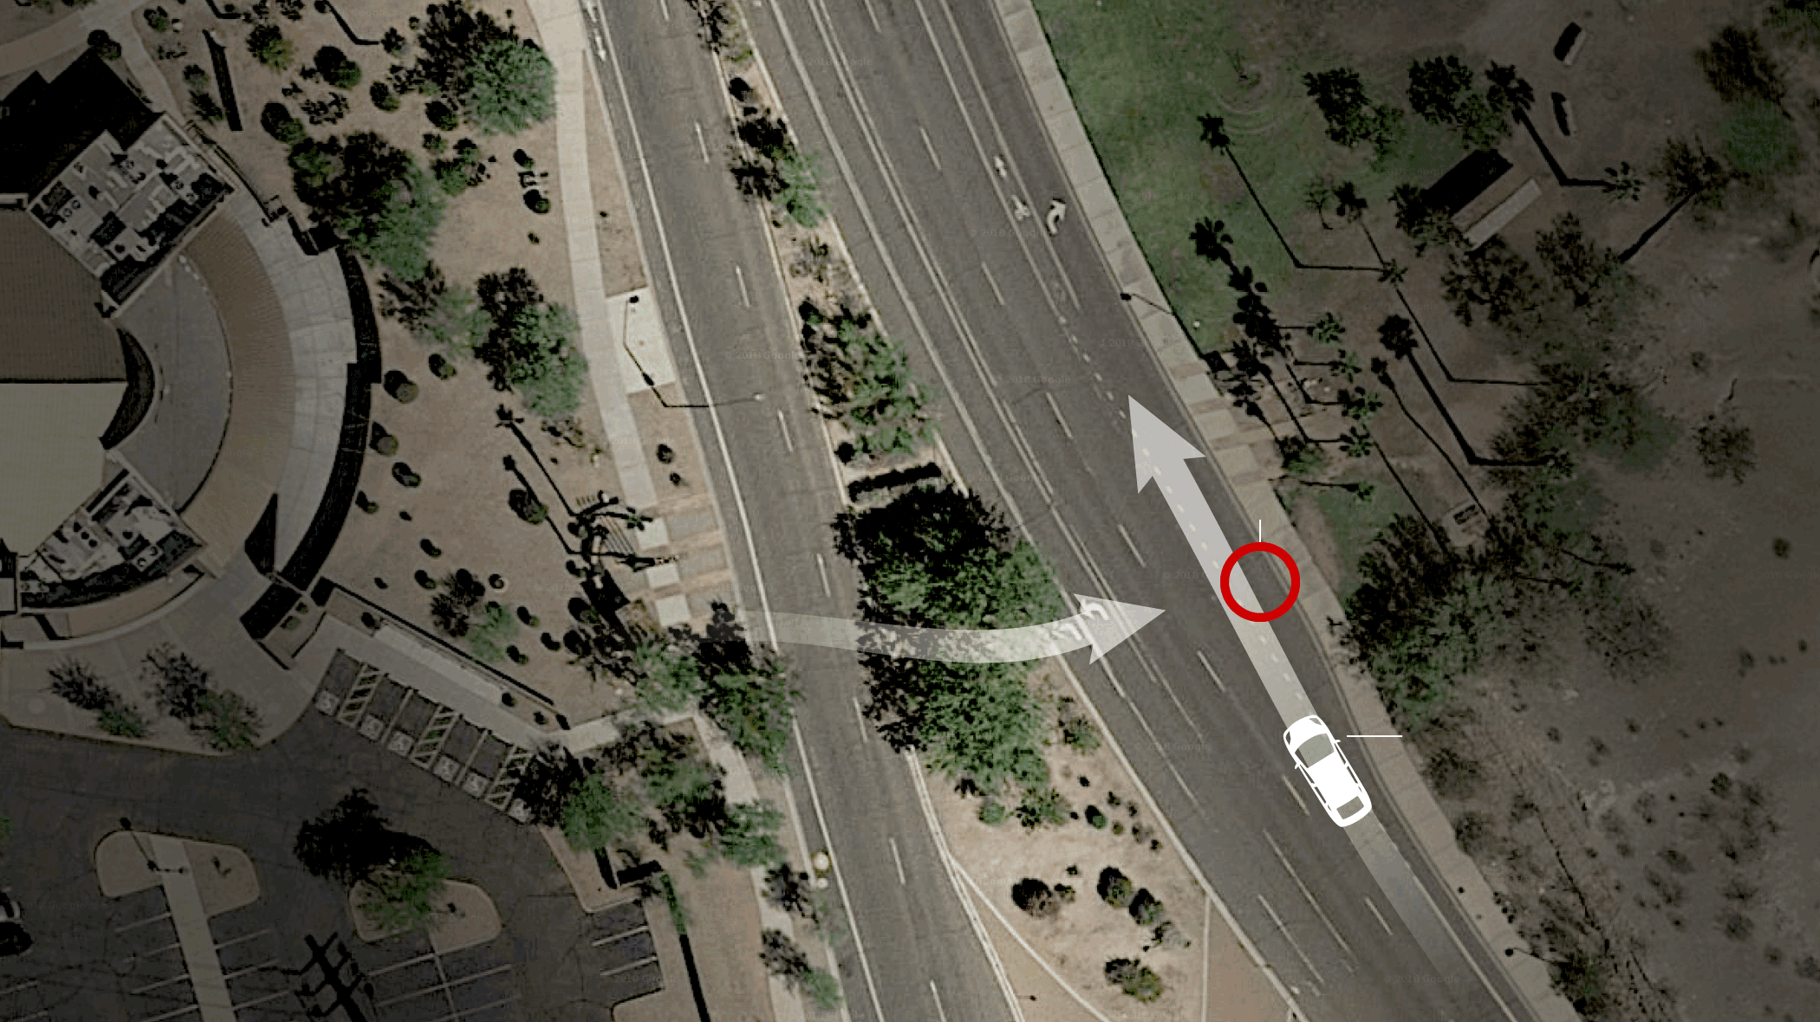
The Uber Pedestrian Fatality in Mar 2018
Police release video of Uber collision that killed pedestrian
https://www.youtube.com/watch?v=q7d90ZFhg28
“The recorded telemetry showed the system had detected Herzberg six seconds before the crash, and classified her first as an unknown object, then as a vehicle, and finally as a bicycle, each of which had a different predicted path according to the autonomy logic.”
Notes:
https://www.nytimes.com/interactive/2018/03/20/us/self-driving-uber-pedestrian-killed.html

Slide 32
The Uber Pedestrian Fatality in Mar 2018
The AV (L3/4) was equipped with both Lidar and Radar. After the woman was detected on the road (6 sec before)
first classified as unknown object
then misclassified as a vehicle
then a bicycle
1.3 sec before, the Volvo system tried to do emergency braking maneuver
but Uber had disabled it for testing
The safety driver was not watching the road moments before the vehicle struck her.
It was probably too dark for the driver to see her in time.
Notes:
https://en.wikipedia.org/wiki/Death_of_Elaine_Herzberg David King, an Arizona State University professor: “This is exactly the type of situation that Lidar and radar are supposed to pick up. This is a catastrophic failure that happened with Uber’s technology.”
Ryan Calo, a University of Washington law professor and self-driving expert: “I really don’t understand why Lidar didn’t pick this up. Shadows don’t matter to Lidar. There is no question it should have been able to see her.”
The XC90 as modified by Uber included a single roof-mounted LiDAR sensor and 10 radar sensors, providing 360° coverage around the vehicle. In comparison, the Fusion had seven LiDAR sensors (including one mounted on the roof) and seven radar sensors. According to Velodyne, the supplier of Uber's LiDAR, the single roof-mounted LiDAR sensor has a narrow vertical range that prevents it from detecting obstacles low to the ground, creating a blind spot around the vehicle. Marta Hall, the president of Velodyne commented "If you're going to avoid pedestrians, you're going to need to have a side lidar to see those pedestrians and avoid them, especially at night."

Slide 33
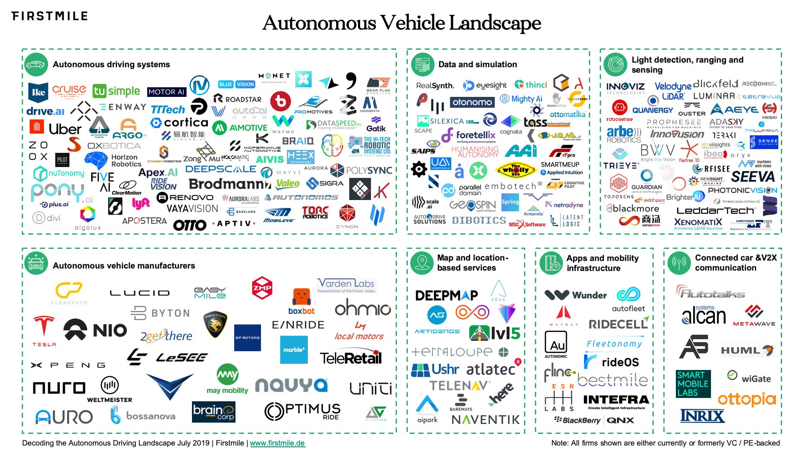
AD Landscape Today
https://medium.com/@firstmilevc/avlandscape-8a21491f1f54

Slide 34
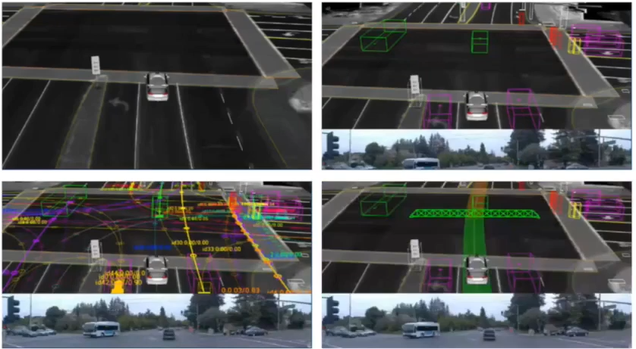
Four Major Tasks of an AV
Localization: Where am I?
Detection: What is around me?
Prediction: Where are they going?
Planning and Control: Where should I go?

Slide 35
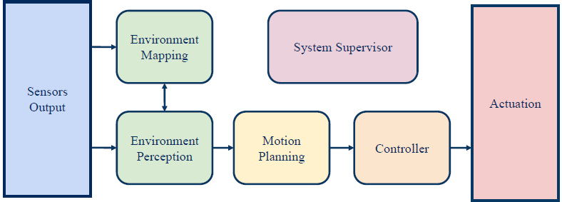
AD Processing Pipeline
Sensing:
Understanding the surrounding environment, incl. localization, detection, prediction
Planning:
Decision making in the context of other road users
Acting:
Moving the vehicle to follow the planned trajectory
Notes:
Environment Perception
Environment Mapping
Motion Planning
Controller
System Supervisor

Slide 36
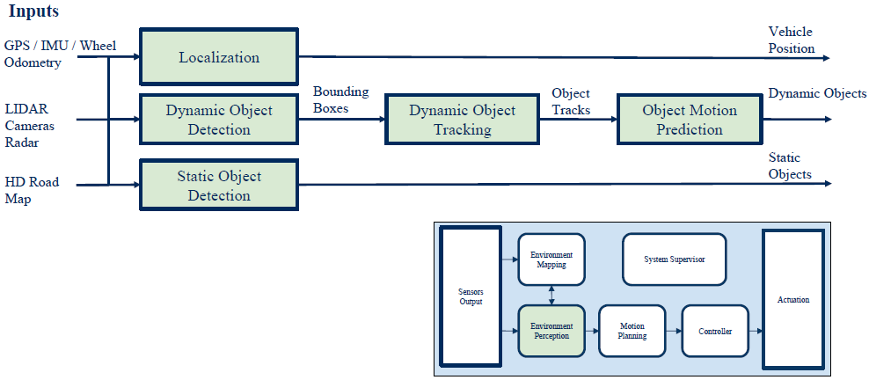
Environment Perception

Slide 37
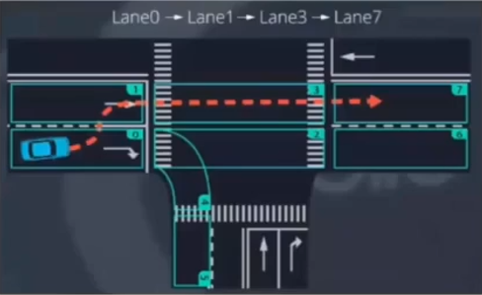
Prediction
Based on state
Kalman filter
Particle filter
Data-driven
ML-based classification
Pedestrian intention prediction
Based on visual cues such as pose, etc.
Very difficult problem

Slide 38
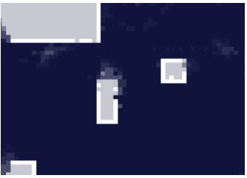
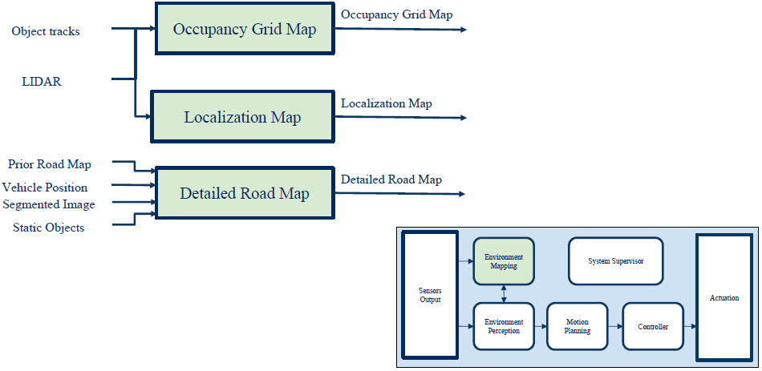
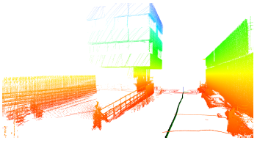
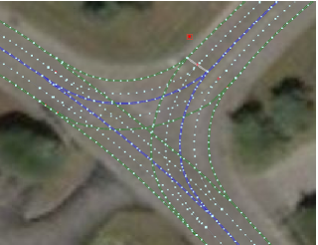
Environmental Maps

Slide 39
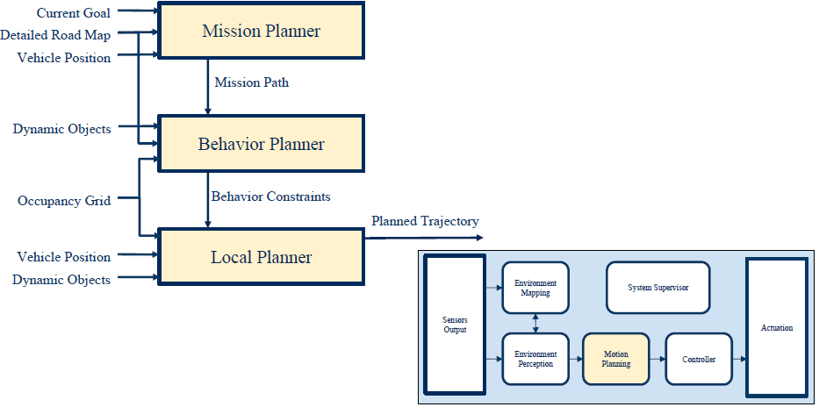
Motion Planning

Slide 40
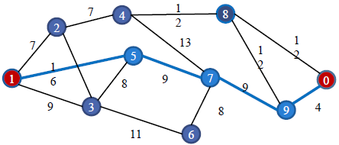
Mission Planner
Use graph search to find a path from source to destination on the map

Slide 41
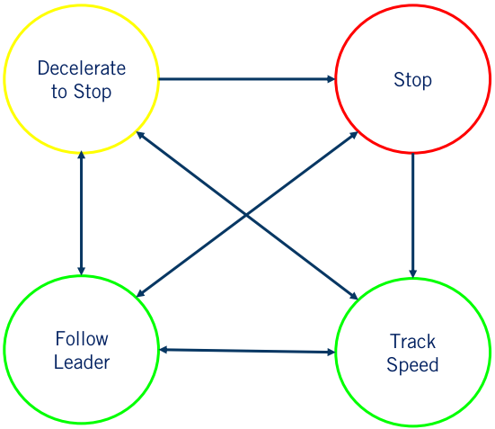
Behavior Planner
Plan the set of high-level driving actions or maneuvers to safely achieve the driving mission under various driving conditions

Slide 42
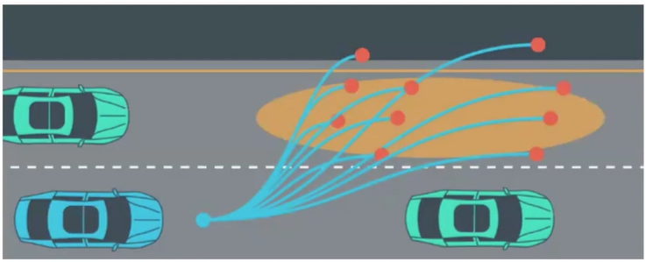
Local Planner
Plan a safe and smooth trajectory (vehicle pose as function of time)

Slide 43
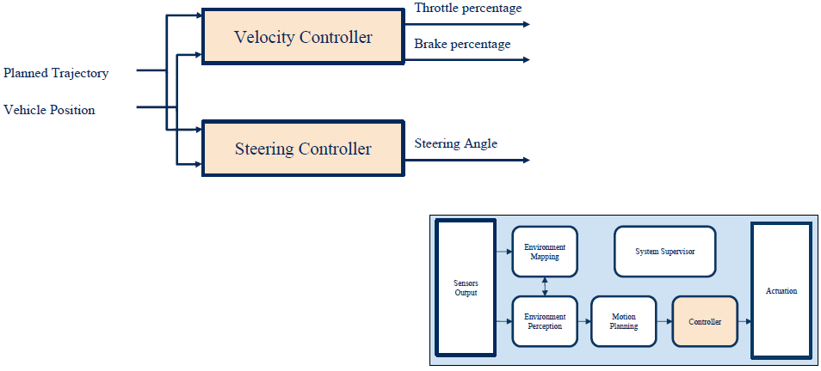
Controller
Velocity controller for longitudinal speed control
Steering controller for lateral speed control
Common control algorithms
PID: Proportional Integral Derivative
MPC: Model-Predictive Control

Slide 44
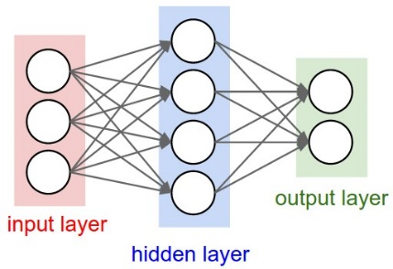
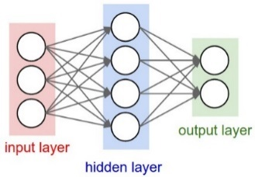
Classic Pipeline vs. ML/DL
Classic AD processing pipeline: separate algorithms for each processing stage.
Where does ML/DL come in?
CNN (Convolutional Neural Networks) for perception is well accepted.
DNN trained with Imitation Learning (IL) or Reinforcement Learning (RL) is still in the early-research stage.
“End-to-end” mapping from pixels to control commands
Many variants of hybrid approaches, e.g., “half-way” mapping from pixels to waypoints used for planning
Several companies are making a bet on it, incl. Waymo, Voyage, Wayve…
Notes:
Perception
e.g., classic Computer Vision algorithms
Decision making
e.g., behavior/path/trajectory planning
Control
e.g., PID, MPC

